Slide 1
2. ROLES OF FIXED- INCOME SECURITIES IN PORTFOLIOS
2.1 Diversification Benefits
The US bond market’s investment-grade sub- sectors were highly correlated with each other, as evidenced by the correlations ranging from 0.77 to 0.95.
International investment-grade bonds, which include US investment-grade bonds, show a 0.54 correlation with the overall US investment- grade bond sector.
The US investment-grade bond sub- sectors exhibited low (and in some cases, negative) correlations with equities, US high- yield bonds, and emerging market bonds.
High- yield bonds, emerging market bonds, and equities exhibited positive correlations with each other, ranging from 0.32 to 0.47.
Importantly, these correlations are not constant over time.

Slide 2
2. ROLES OF FIXED- INCOME SECURITIES IN PORTFOLIOS
2.2 Benefits of Regular Cash Flows
Regular cash flows allow investors—both individual and institutional—to plan how to meet, with some degree of predictability, known future obligations such as tuition payments, pension obligations, or payouts on life insurance policies.
It is important to note that reliance on regular cash flows assumes that no credit event or other market event (such as a decrease in interest rates increasing prepayments of mortgages underlying mortgage- backed securities) will occur

Slide 3
2. ROLES OF FIXED- INCOME SECURITIES IN PORTFOLIOS
2.3 Inflation Hedging Potential
 | Coupon | Principal
Fixed coupon bond | Unprotected | Unprotected
Floating coupon bond | Protected | Unprotected
Inflation linked bond | protected | Protected

Slide 4
3. FIXED- INCOME MANDATES
Fixed- income mandates can be broadly classified into liability- based mandates and total return mandates.
Liability- based mandates are managed to match or cover expected liability payments with future projected cash inflows.
Total return mandates are generally managed in an attempt to either track or outperform a market- weighted fixed- income benchmark such as the Bloomberg Barclays Global Aggregate Index.

Slide 5
3. FIXED- INCOME MANDATES
3.1 Liability- Based Mandates
3.1.1 Cash Flow Matching
Cash flow matching attempts to ensure that all future liability payouts are matched precisely by cash flows from bonds or fixed- income derivatives, such as interest rate futures, options, or swaps.

Slide 6
3. FIXED- INCOME MANDATES
3.1.2 Duration Matching
Conditions that need to be satisfied to achieve immunization using duration matching include the following: (1) A bond portfolio’s duration must equal the duration of the liability portfolio; and (2) the present value of the bond portfolio’s assets must equal the present value of the liabilities at current interest rate levels.
A crucial limitation of immunization is that it protects against only a parallel change in the yield curve—that is, the same yield change across the entire maturity spectrum of the yield curve.
If interest rates decrease, reduced reinvestment income is offset by an increase in bond prices. If interest rates increase, higher reinvestment income offsets the decrease in bond prices.

Slide 7
3. FIXED- INCOME MANDATES
It is important to note other considerations for an immunized portfolio:
A portfolio is an immunized portfolio only at a given point in time.
The need to rebalance makes liquidity considerations important.
Rebalancing and the need to liquidate positions can result in high portfolio turnover.
Immunization assumes that bond issuers do not default.
Immunization can accommodate bonds with embedded options to the extent that a bond’s duration is replaced by its effective duration as an input to the methodology.

Slide 8
3. FIXED- INCOME MANDATES
3.1.3 Contingent Immunization
A commonly used hybrid approach is known as contingent immunization, which combines immunization with an active management approach when the asset portfolio’s value exceeds the present value of the liability portfolio.
3.1.4 Horizon Matching
Another hybrid approach, horizon matching, combines cash flow and duration matching approaches. The short- term liability portion (usually liabilities up to about four or five years) is covered by a cash flow matching approach, whereas the long term liabilities are covered by a duration matching approach.

Slide 9
3. FIXED- INCOME MANDATES
3.2 Total Return Mandates
Total return mandates can establish objectives based on a specified absolute return or a relative return. Generally structured to either track or outperform a specified bond index, total return mandates are the focus of this discussion.
Approaches range from a pure indexing approach that has targeted active return and active risk (tracking error) of zero to fully active approaches that substantially deviate from the benchmarks and attempt to generate significant excess (or active) returns.

Slide 10
3. FIXED- INCOME MANDATES
 | Pure indexing | Enhanced indexing | Active management
Objective | Match benchmark return and risk as closely as possible | Modest outperformance (generally 20 bps to 30 bps) of benchmark while active risk is kept low (typically around 50 bps or lower) | Higher outperformance (generally around 50 bps or more) of benchmark and higher active risk levels
Portfolio weights | Ideally the same as benchmark or only slight mismatches | Small deviations from underlying benchmark | Significant deviations from underlying benchmark
Risk factor matching | Risk factors are matched exactly | Most primary risk factors are closely matched (in particular, duration) | Large risk factor deviations from benchmark (in particular, duration)
Turnover | Similar to underlying benchmark | Slightly higher than underlying benchmark | Considerably higher turnover than the underlying benchmark

Slide 11
4. BOND MARKET LIQUIDITY
Fixed- income securities vary greatly in their liquidity.
Recently issued “on- the run” sovereign government bonds may be very liquid and trade frequently at narrow bid–ask spreads. Other bonds, such as corporate and non- sovereign government bonds, may be very illiquid.
Compared with equities, fixed- income markets are generally less liquid.
Bond liquidity is typically highest right after issuance.
Liquidity typically affects bond yields. Bond investors require higher yields for investing in illiquid securities relative to otherwise identical securities that are more liquid.

Slide 12
4. BOND MARKET LIQUIDITY
4.1 Liquidity among Bond Market Sub- Sectors
 | More liquid | Less liquid
Issuer type | Sovereign government bonds | Corporate and non-Sovereign government bonds
Credit quality | high credit quality | lower credit quality
Issue size | Larger issue | Smaller issue
Maturity | nearer- term bonds | longer maturities

Slide 13
4. BOND MARKET LIQUIDITY
4.2 The Effects of Liquidity on Fixed- Income Portfolio Management
4.2.1 Pricing
For bonds that trade infrequently, a common investor approach is matrix pricing. Matrix pricing uses the recent transaction prices of comparable bonds to estimate the market discount rate or required rate of return on less frequently traded bonds.
The comparable bonds have similar features such as credit quality, time to maturity, and coupon rate to the illiquid bond.
A benefit of matrix pricing is that it does not require sophisticated financial modeling of bond market characteristics such as term structure and credit spreads.
A disadvantage is that some value-relevant features between different bonds (for example, call features) may be ignored.

Slide 14
4. BOND MARKET LIQUIDITY
4.2.2 Portfolio Construction
In constructing a portfolio, investors must consider an important trade-off between yield and liquidity.
A number of different factors determine the bid–ask spread.
Higher bid-ask spread | Lower bid-ask spread
Illiquidity bond(riskier bond)
corporate bonds or structured financial instruments | government bonds
corporate bonds with non- standard or complex features | Conventional (plain vanilla) corporate bonds
smaller, less creditworthy companies | Bonds of large, high- credit- quality corporations

Slide 15
4. BOND MARKET LIQUIDITY
4.2.3 Alternatives to Direct Investment in Bonds
As we have discussed, transacting in fixed- income securities may present challenges because of low liquidity in many global bond markets.
As an alternative, investors can use fixed- income derivatives, which are often more liquid than their underlying bonds. Such fixed- income derivatives include those traded on an exchange (for example, futures and options on futures) and those traded over the counter (for example, interest rate swaps and credit default swaps).
Fixed- income exchange- traded funds (ETFs) and pooled investment vehicles (such as mutual funds) have emerged as another alternative to transacting in individual bonds.

Slide 16
5. A MODEL FOR FIXED- INCOME RETURNS
5.1 Decomposing Expected Returns
Yield income
Roll down return
Rolling yield=yield income + roll down return
E(Change in price based on investor’s views of yields and yield spreads)
Expected credit losses
Expected currency gains or losses

Slide 17
5. A MODEL FOR FIXED- INCOME RETURNS
Example:
Notional principal of portfolio (in millions) €200
Average bond coupon payment (per €100 par value) €2.25
Coupon frequency Annual
Current average bond price €98.45
Expected average bond price in one year (assuming an unchanged yield curve)€98.62
Average bond convexity 22
Average bond modified duration 5.19
Expected average yield and yield spread change 0.15%
Expected credit losses 0.13%
Expected currency gains (€ appreciation vs. $) 0.65%

Slide 18
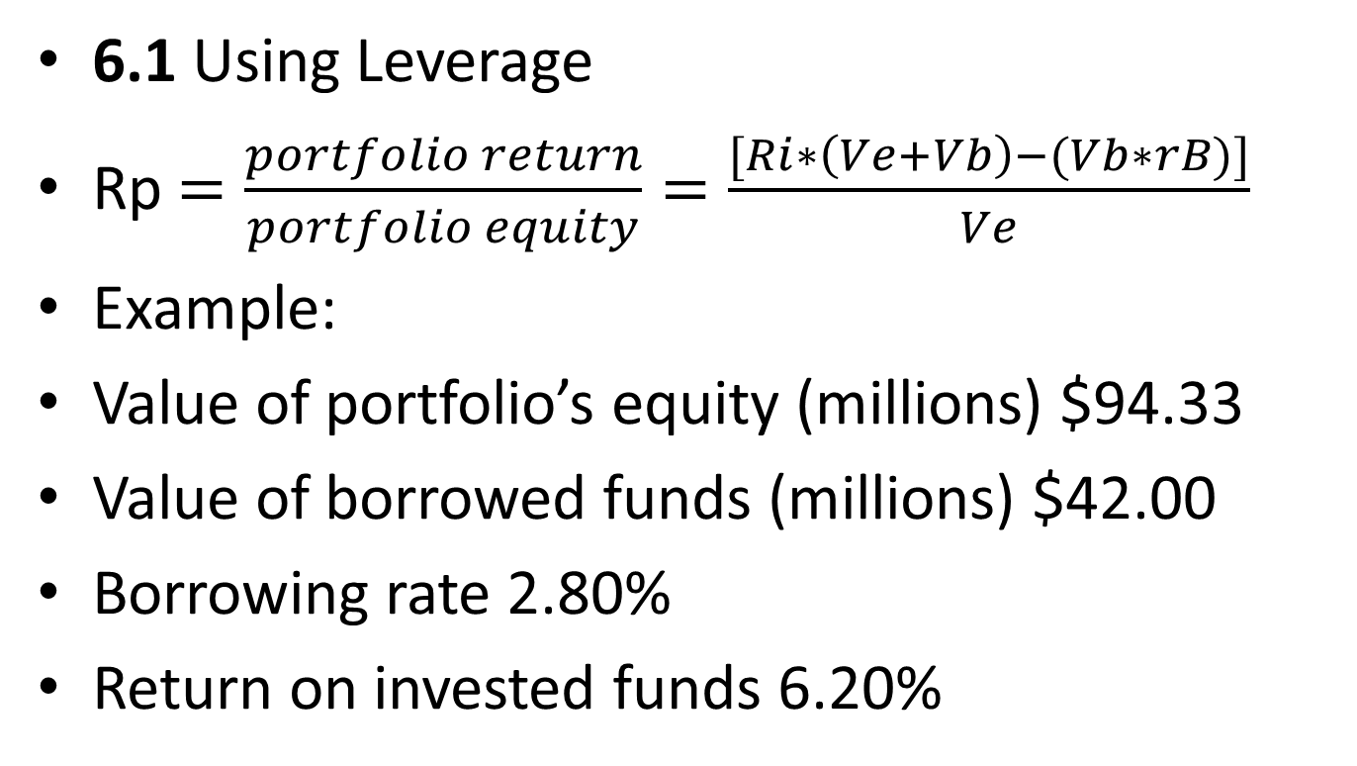
6. LEVERAGE
6.1 Using Leverage
Rp $=\frac{portfolio return}{portfolio equity}=\frac{[Ri∗\left(Ve+Vb\right)−(Vb∗rB)]}{Ve}$
Example:
Value of portfolio’s equity (millions) $94.33
Value of borrowed funds (millions) $42.00
Borrowing rate 2.80%
Return on invested funds 6.20%

Slide 19
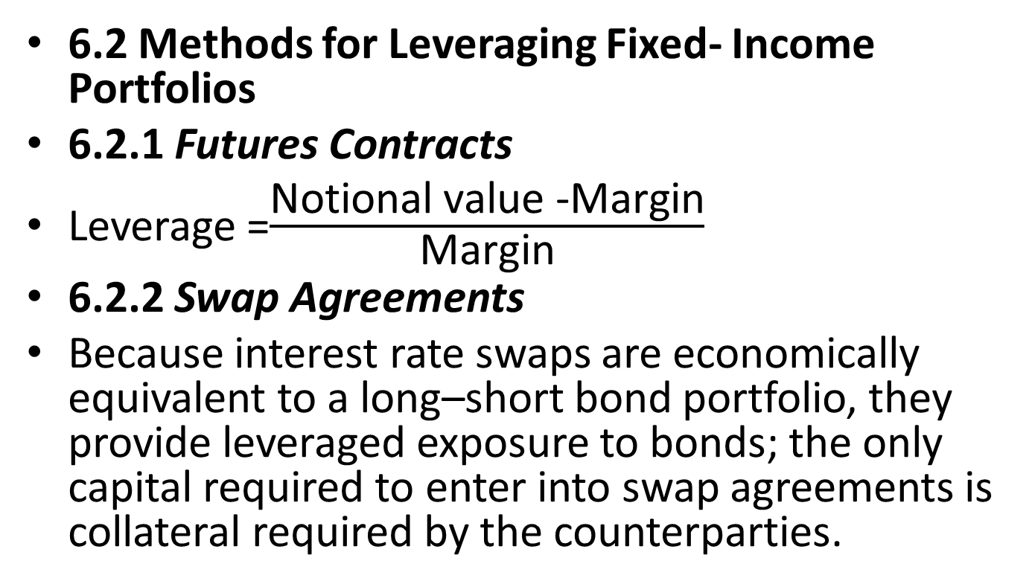
6. LEVERAGE
6.2 Methods for Leveraging Fixed- Income Portfolios
6.2.1 Futures Contracts
Leverage =$\frac{\text{Notional} \text{value}\text{ −}\text{Margin}}{\text{Margin}}$
6.2.2 Swap Agreements
Because interest rate swaps are economically equivalent to a long–short bond portfolio, they provide leveraged exposure to bonds; the only capital required to enter into swap agreements is collateral required by the counterparties.

Slide 20
6. LEVERAGE
6.2.3 Structured Financial Instruments
An inverse floater’s defining feature is that its coupon has an inverse relationship to a market interest rate such as Libor.
Coupon rate = 15% – (1.5 * Libor3- month)
The inverse floater exacerbates the magnitude of the inverse relationship between bond prices and interest rates.

Slide 21
6. LEVERAGE
6.2.4 Repurchase Agreements
In a repurchase agreement, a security owner agrees to sell a security for a specific cash amount while simultaneously agreeing to repurchase the security at a specified future date (typically one day later) and price.
6.2.5 Securities Lending
The primary motive of securities lending transactions is to facilitate short sales, which involve the sale of securities the seller does not own.
Another motive for securities lending transactions is financing, or collateralized borrowing.

Slide 22
6. LEVERAGE
6.3 Risks of Leverage
Leverage alters the risk–return properties of an investment portfolio.
A heavily leveraged portfolio may incur significant losses even when portfolio assets suffer only moderate valuation declines. Leverage can lead to forced liquidations.

Slide 23
7. FIXED- INCOME PORTFOLIO TAXATION
7.1 Principles of Fixed- Income Taxation
The two primary sources of investment income that affect taxes for fixed income securities are coupon payments (interest income) and capital gains or losses.
In general, tax is payable only on capital gains and interest income that have actually been received.
Capital gains are frequently taxed at a lower effective tax rate than interest income.
Capital losses generally cannot be used to reduce sources of income other than capital gains.

Slide 24
7. FIXED- INCOME PORTFOLIO TAXATION
7.2 Investment Vehicles and Taxes
In a pooled investment vehicle (sometimes referred to as a collective investment scheme) such as a mutual fund, interest income is generally taxed at the final investor level when it occurs—regardless of whether the fund reinvests interest income or pays it out to investors.
In a separately managed account, an investor typically pays tax on realized gains in the underlying securities at the time they occur.

